Slide 1





SYRACUSE UNIVERSITY
IST722 – Data Warehouse Group - 7
Kruti
Lokesh
Ravi
Karthik
Priyanka

Slide 2
Contents:
Data Exploration.
Business case
High level Modeling.
Detailed Dimension Modeling.
ETL and examples of data pulled.
Cube structure for better identification.
Descriptive Dashboard in Power BI with filters.
Insights.

Slide 3
Data Exploration
We are presented with data from Fudgemart, inc. which has two subsidiary companies called Fudgemart and Fudgeflix.
Fudgemart is an online retailer who has customers, products, vendors and various other business process that you would find in an online retailer.
Fudgeflix is DVD by mail and video on demand service. Data of Fudgeflix include accounts, subscriptions and video titles and various other things that comes with online streaming service.

Slide 4
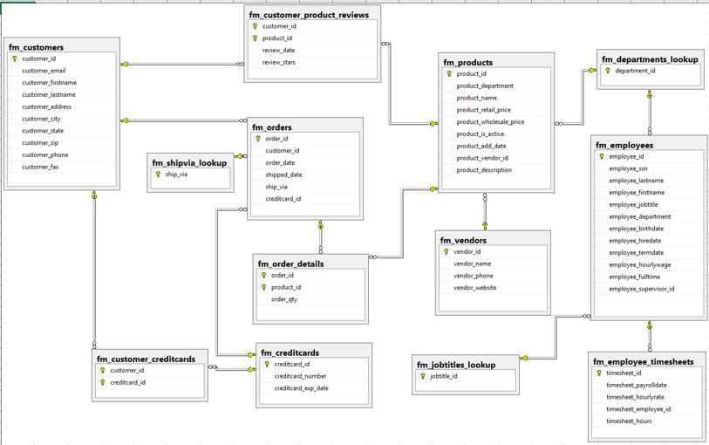
Fudgemart Database Schema

Slide 5
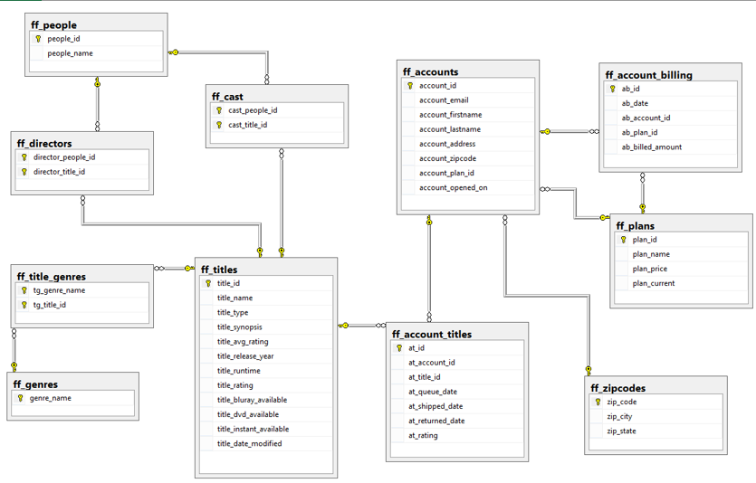
Fudgeflix Database Schema

Slide 6

Business Case: Revenue streams
Revenue is the income generated from normal business operations and includes discounts and deductions for returned merchandise. It is the top line or gross income figure from which costs are subtracted to determine net income.
Revenue defines the position of the company in this competitive world.
Growth of a company can be estimated by looking at the revenues over a period.
Creditors looks at the revenue of company before funding.

Slide 7


What data can say?
Revenue generated by subsidiaries
Quarter/ year wise performance
Region/State wise earnings
Department wise contribution
Any trends/ seasonality in the data
Interesting patterns/insights
Highest contributing states
Which cities spending more?
Highest spending months
Product → Subscription plan
Department → Subscription Plan
Orders → Billings

Slide 8
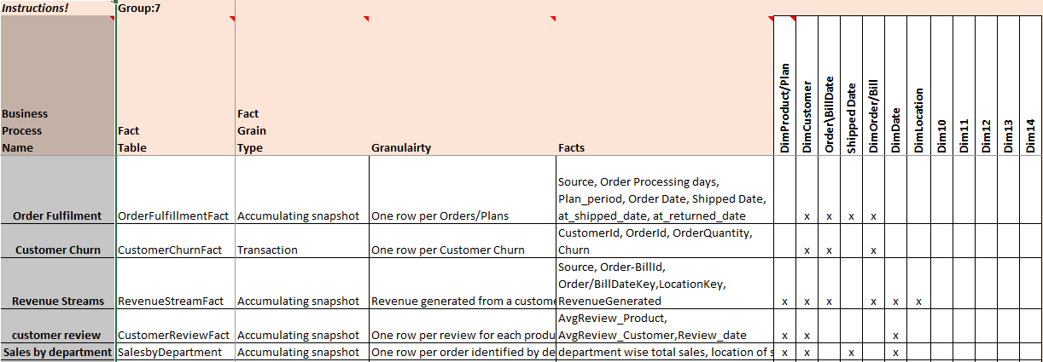
High Level Modeling

Slide 9
ETL
Extract, Transform and Load is abbreviated as ETL.
This process is used to pull the data out of the database and stage it to perform data manipulations
After manipulation data is pushed into the warehouse.
We have two different databases here one for fudgemart and one for fudgeflix.
We pulled the data related to the business case from both database into a single stage.
Staged data is transformed to the required schema.

Slide 10
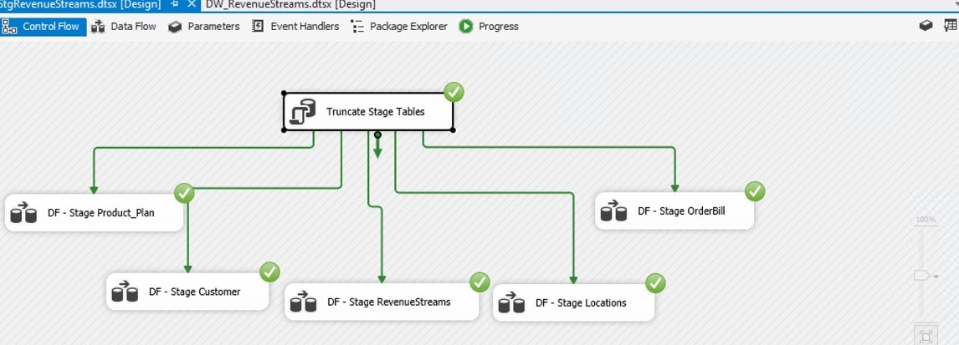
Control Flow for Staging

Slide 11
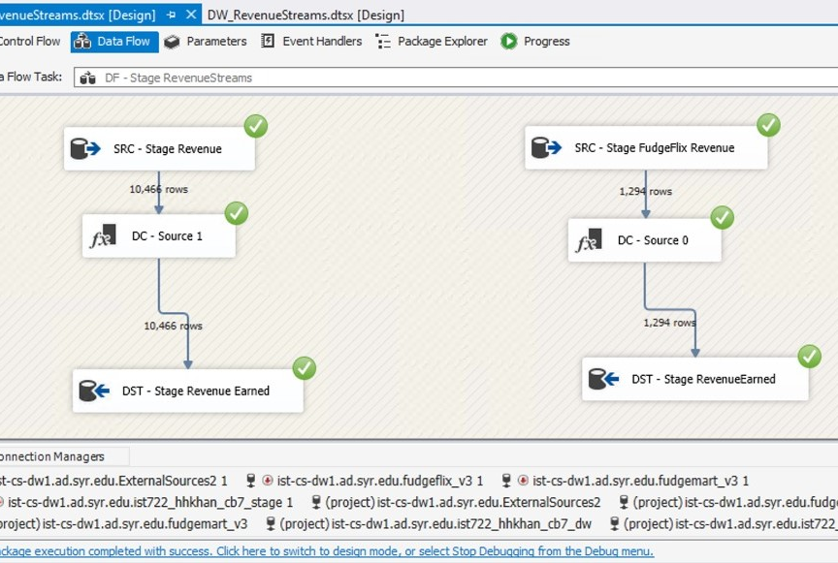
Data Flow for Staging

Slide 12
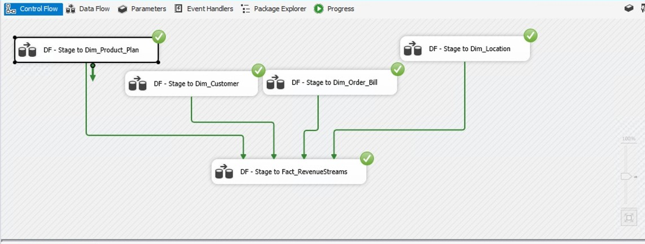
Control Flow for Data Warehouse

Slide 13
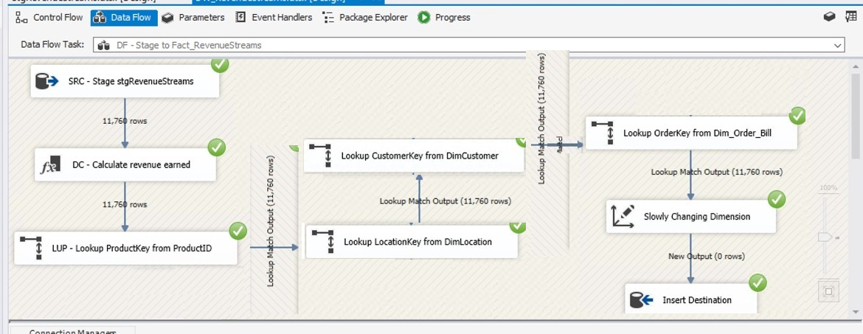
Data Flow for Data Warehouse

Slide 14
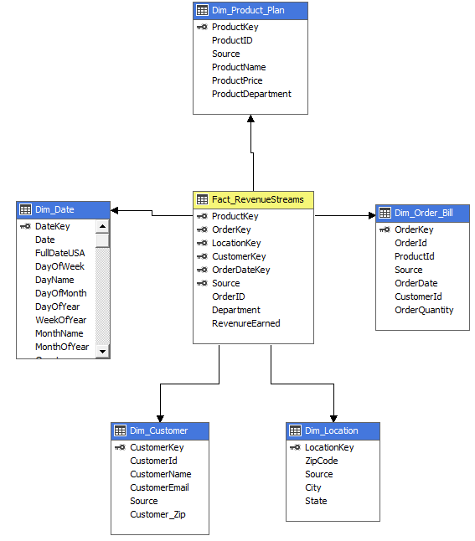
Star Schema

Slide 15
BI Visualizations
As we are done with pulling data from database into the data warehouse all is left is to get some insights out of the data.
We are using PowerBI to get visualizations to get graphical insights.
These visualizations gives us an easily understandable summarized insights of the data present.
We can add filters to observe specific insights and to make a summarized assumptions.

Slide 16
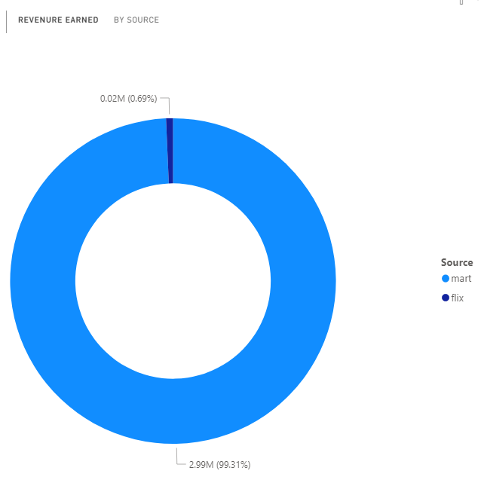
Revenue by Subsidary Firms

Slide 17
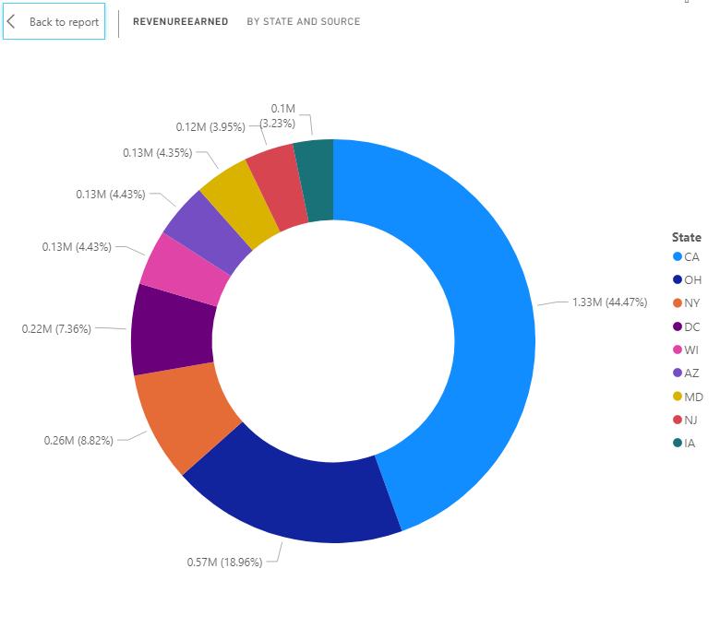
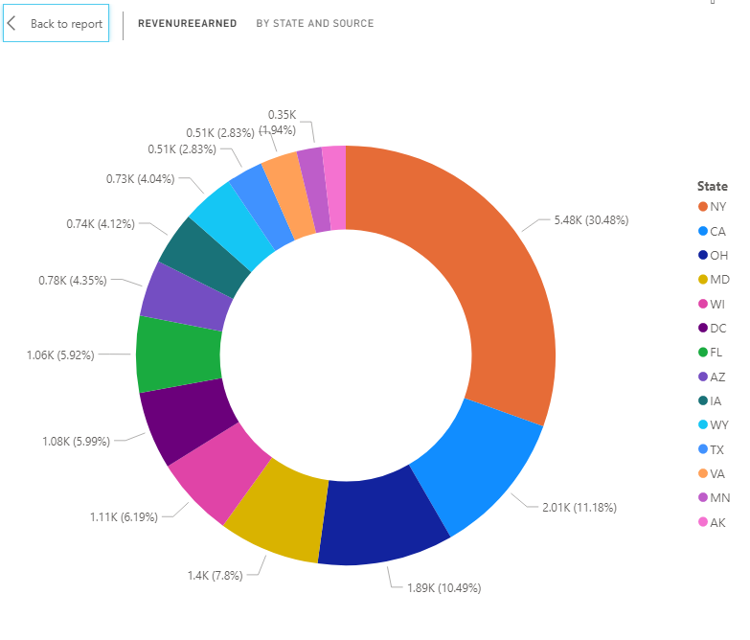
Detailed visualization of revenues between two firms by state.

Slide 18
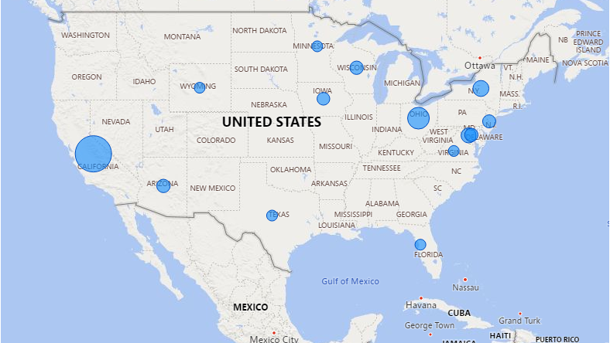
Map showing Revenues by State

Slide 19
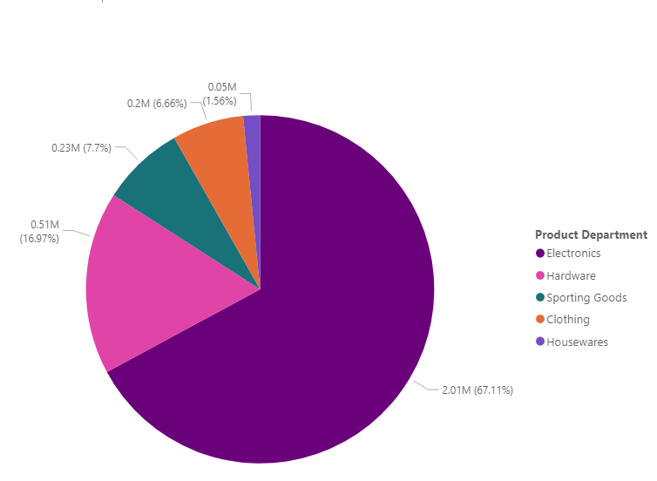
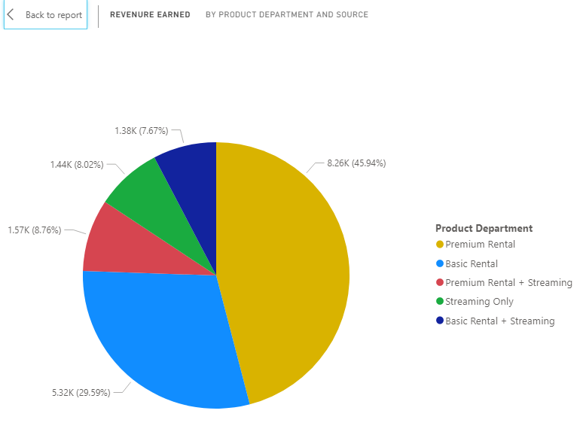
Detailed representation of revenue by category

Slide 20


Challenges/improvements
Integrating two databases
Location of customers directly available in fudgeflix but must be extracted from customers' table
mapping locations with revenue generated
In publishing Power BI dashboard to public domain
Recommendations
Following similar schema in both data bases possible extent
Keeping common record of customers, addresses and locations
Business Recommendations
Services vs Products
Selling individual DVD/titles fudgemart without subscription
Using fudgemart delivery/warehouse network to expand fudgeflix
Formulate separate strategy for fudgeflix services
Divide geographic regions into small regions based on revenue

Slide 21
Thank you Happy Holidays

